Slide 1



Selected Topics in Machine Learning
Shahd Aleissa
Maryam Alakkas
Shahad Aljafaari
Afnan Mhran
7:00- 9:30 PM
Notes:
Please add the title of the session "Selected Topics in Machine Learning", as well as the names of the speakers :)
I would like to see some changes to the design. It contains too graphic heavy and colorful, so I would appreciate it if you could simplify it.

Slide 2

TABLE OF CONTENTS
01
Hyperparameter Optimization
02
Feature Selection
03
Ensemble Techniques

Slide 3

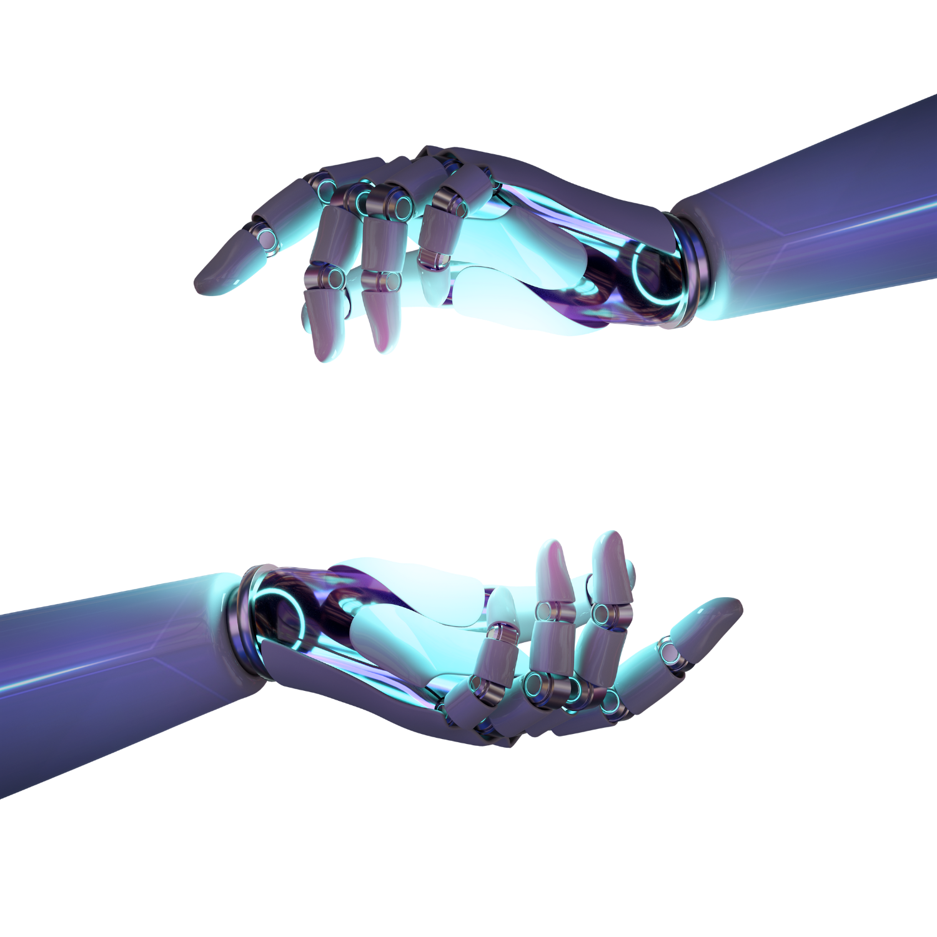

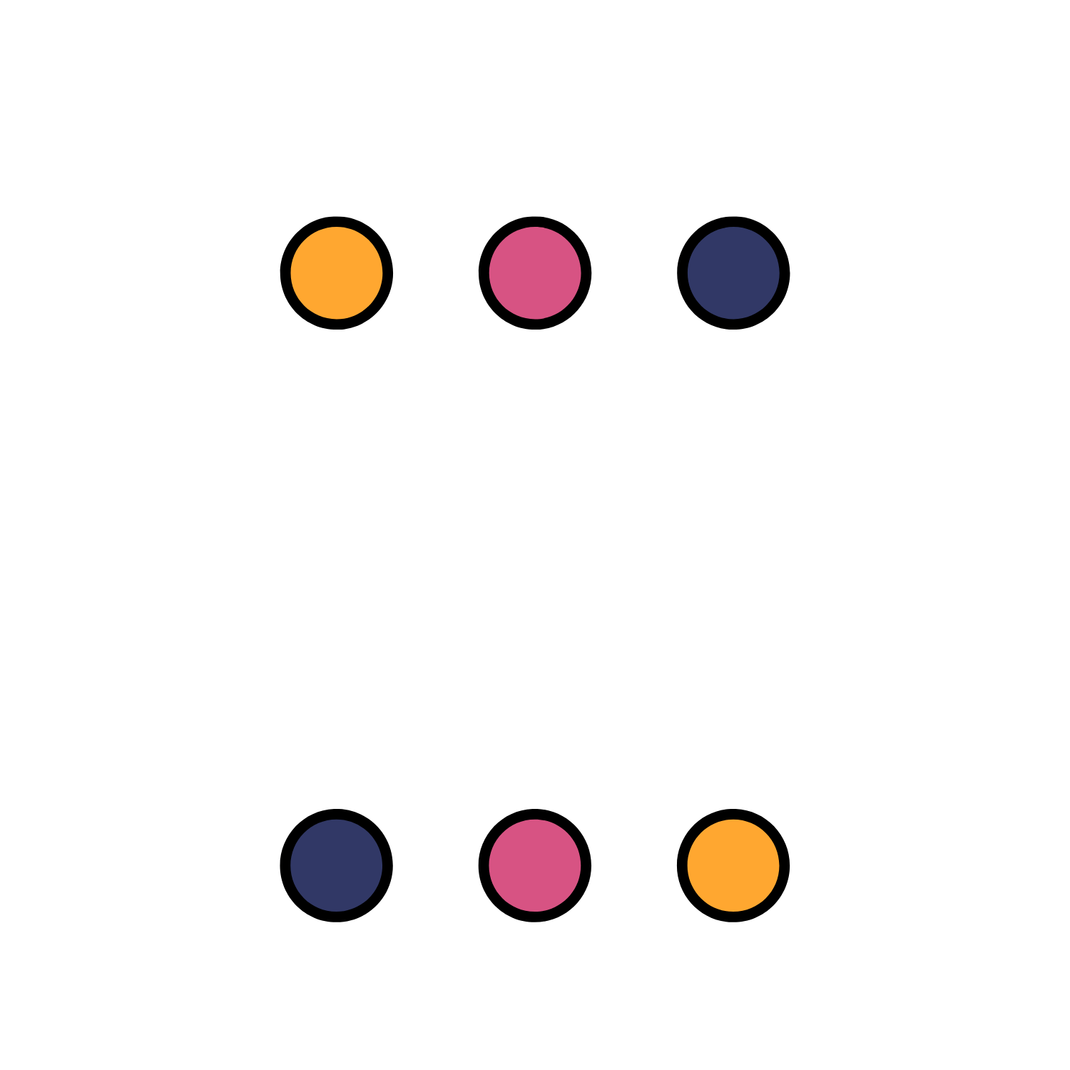
01
HYPERPARAMETER OPTIMIZATION
Speaker: Shahd Aleissa

Slide 4


HYPERPARAMETER TUNING (OPTIMIZATION)
the problem of choosing a set of optimal hyperparameters for a learning algorithm
WHAT IS A HYPERPARAMETER?
a parameter whose value is used to control the learning process
BUT .. WHY?
Hyperparameter tuning is an essential part of controlling the behavior of a machine learning model unless we correctly tune our hyperparameters our estimated model parameters produce suboptimal results as they don’t minimize loss function meaning the model makes more errors
Notes:
It would be better to begin with the concept of hyperparameter tuning (optimization), why do we use it? Next, the approaches or techniques used.

Slide 5
HYPERPARAMETER OPTIMIZATION APPROACHS
1
2
3
MANUAL
SEARCH
RANDOM SEARCH
GRID
SEARCH
we choose some model hyperparameters based on our judgment /experience. We then train the model, evaluate its accuracy and start the process again. This loop is repeated until a satisfactory accuracy is scored.
we create a grid of hyperparameters and train/test our model on just some random combination of these hyperparameters.
we set up a grid of hyperparameters and train/test our model on each of the possible combinations.
Notes:
Please mention and briefly describe only three techniques

Slide 6
WE WILL FOCUS ON GRID SEARCH..
Using Scikit-learn function GridSearchCV

Slide 7
02
Feature Selection
Speaker: Maryam Alakkas

Slide 8
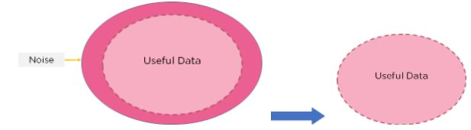
Feature Selection
What?
Why?
Feature Selection is the method of reducing the input variable to your model by using only relevant data and getting rid of noise in data.
Machine learning models follow a simple rule: whatever goes in, comes out. If we put garbage into our model, we can expect the output to be garbage too. In this case, garbage refers to noise in our data. Apart from choosing the right model for our data, we need to choose the right data to put in our model. Eventually, we will improve accuracy , reduce training time and reduce overfitting.
Noisy data is meaningless data
Notes:
I think the two parts should be switched: Why part (on the right), and what part (on the left). And in the why section consider adding how it will help in capturing the problem and reducing the costs of collecting data.
-------

Slide 9
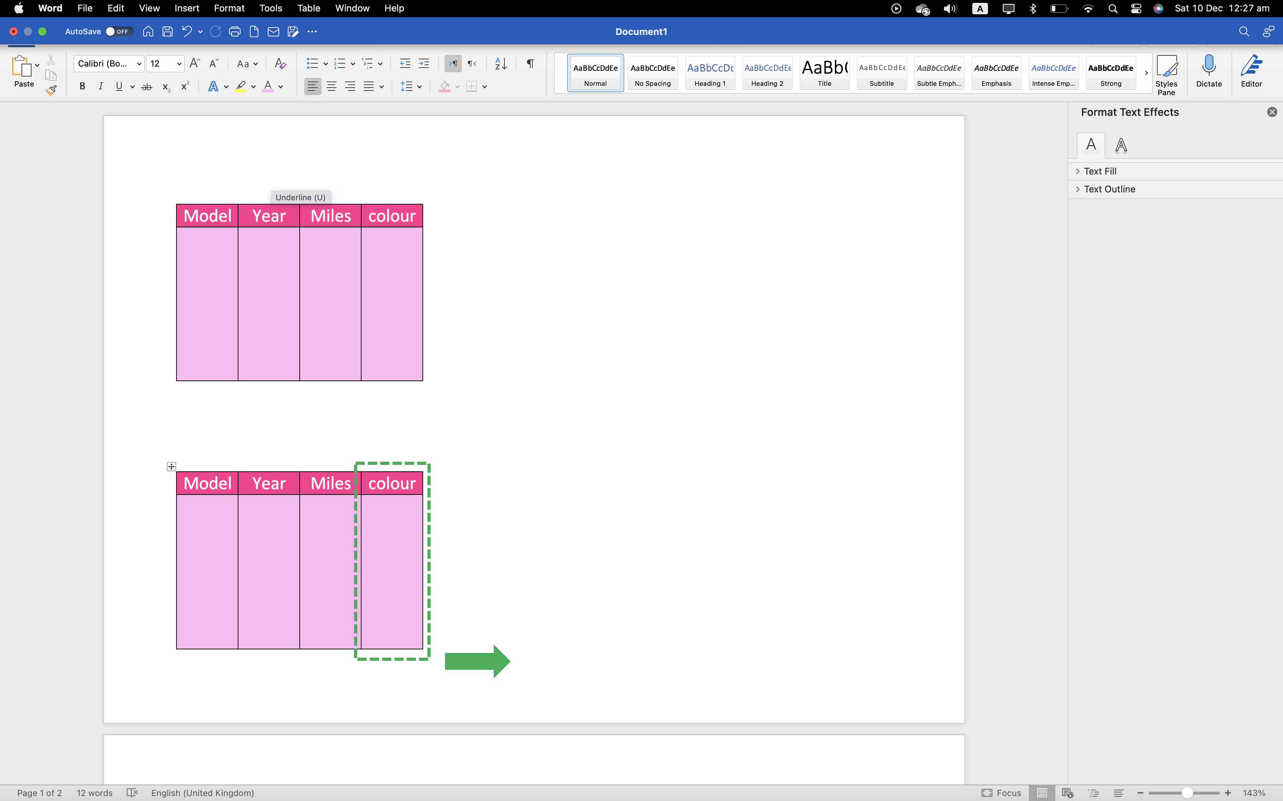
Feature Selection
As seen in table, that the model of the car, the year of manufacture, and the miles it has travelled are pretty important to find out if the car is old enough to be crushed or not. However, the colour of the car does not decide if the car should be crushed or not. Further, it can confuse the algorithm into finding patterns between names and the other features. Hence we can drop the column
Consider a table that contains information of old cars. The model decides which cars must be crushed.
Notes:
.Actually what you have mentioned is a part of preprocessing,
feature selection is interested in eliminating both useful and non useful features based on a specified technique. For example, the year gives a useful information but a statical approach may calculate that this information is irrelevant to whether the car will crush or not. Also, I think point 2 needs to be rephrased and clarified more, please.

Slide 10
Feature selection methods
Filter Method: provides a set of “the most important variables” as the resulting subset independently of the employed model.

Slide 11
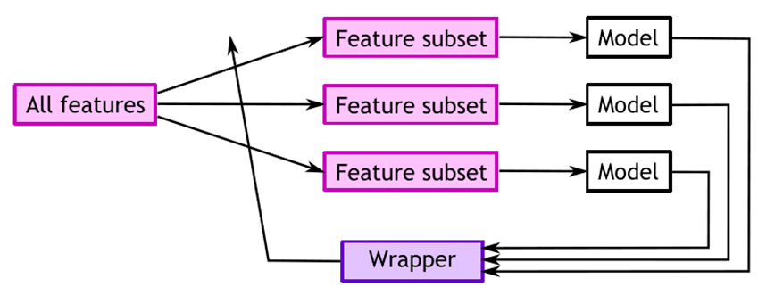
Feature selection methods
Wrapper Method: the process is based on a specific machine learning algorithm that we are trying to fit on a given dataset.
forward step
types of wrapper
backward step
Notes:
We split our data into subsets and train a model using it. Based on the output of the model, it is chosen which subsets will be tested in the next iteration.

Slide 12
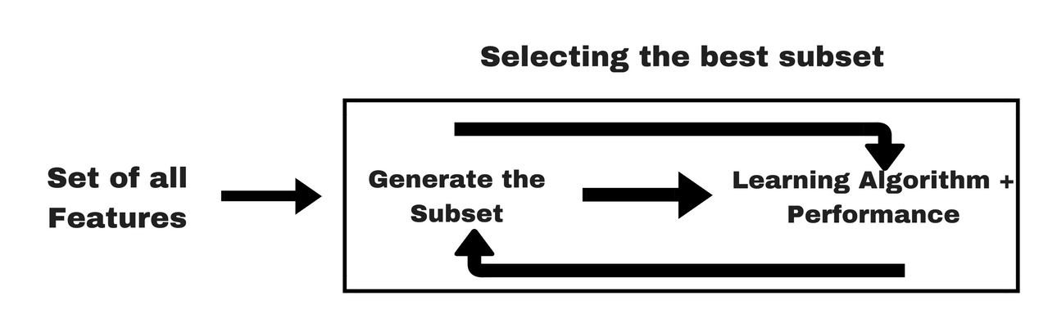
Feature selection methods
Embedded Method: Integrated or built into the classifier algorithm. During the training step, the classifier adjusts its internal parameters and determines each feature’s importance to produce the best classification accuracy.

Slide 13
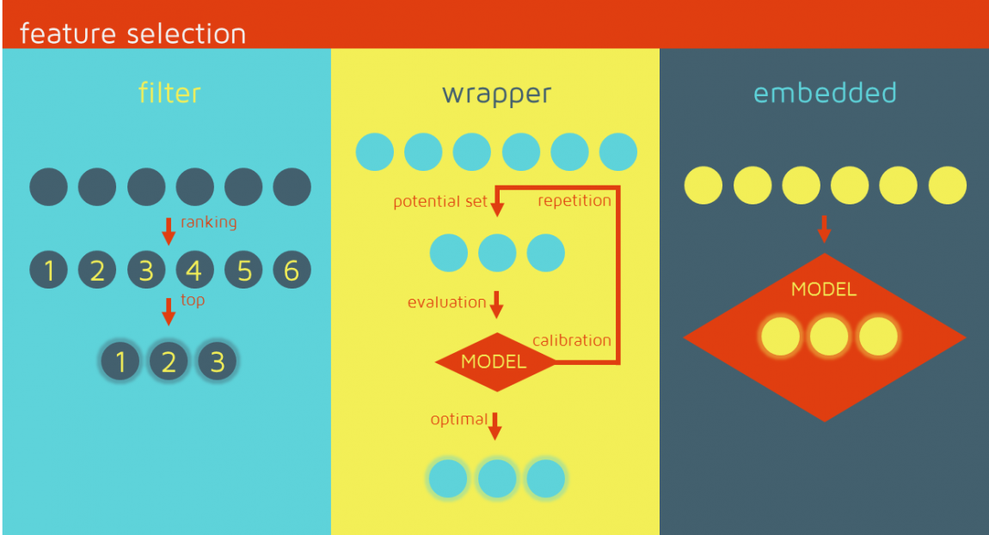
Review

Slide 14
03
Ensemble Techniques
Speakers: Shahad Aljafaari and Afnan Mhran

Slide 15
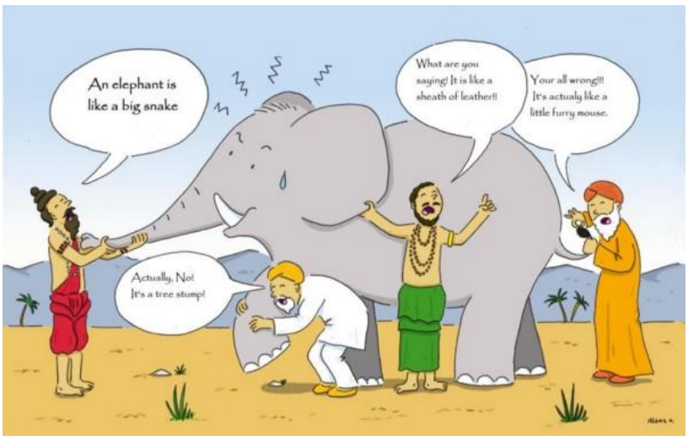
Ensemble
is a general meta-approach to machine learning that seeks better predictive performance by combining the predictions from multiple models.
Notes:
Ensamble model: Combine Weak classifier to generate strong classifier

Slide 16
Why use Ensemble Models
Better Accuracy (Low Error)
Higher Consistency (Avoids Overfitting)
Reduce Bias and Variance Errors.

Slide 17
?
When and Where to
use Ensemble Techniques
Single Model Overfits.
Results worth the extra training.
Can be used for classification as well as regression.

Slide 18
Techniques of Ensemble Methods :
01
Voting (improves prediction)
02
Boosting (reduce the Bias)
03
Bagging (Bootstrap Aggregating)
04
Stacking

Slide 19
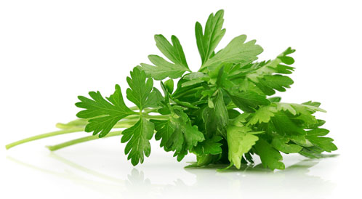
Guess with me
Notes:
One example of a real-world problem that can be solved by the voting ensemble method is predicting the outcome of an election. By combining the predictions of multiple models, you can produce a more accurate prediction of who will win the election. This can be helpful for political campaigns, news outlets, and voters themselves.

Slide 20

Voting (improves prediction)
The voting ensemble method combines the predictions of multiple models by voting. The voting can be used to make more accurate predictions than any single model by combining the knowledge and expertise of multiple experts.
The idea is that, by pooling the predictions of multiple models, you can reduce the variance and avoid overfitting.
Voting is typically used when there are multiple models with different configurations, or when there are multiple experts with different opinions. In either case, it can help to produce a more accurate prediction by aggregating the information from multiple sources.
Notes:
Doctors as example.

Slide 21
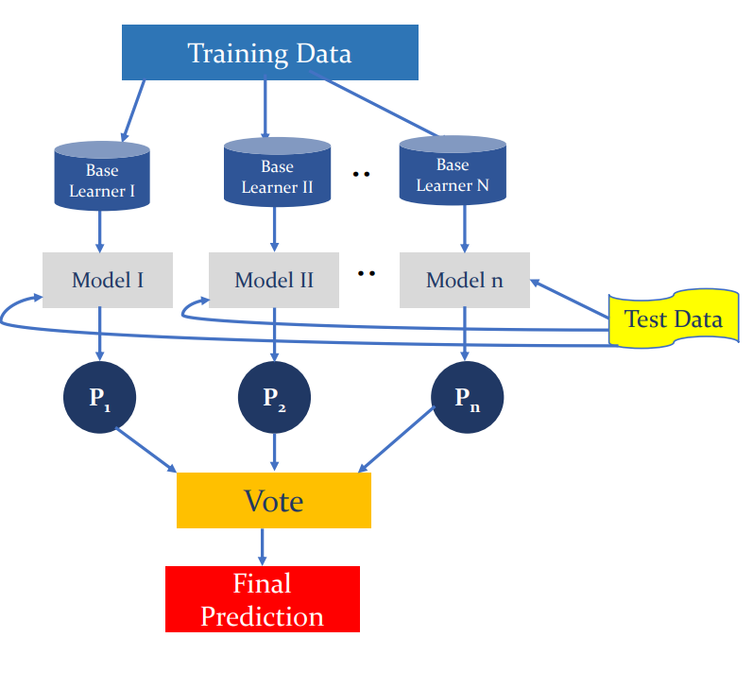
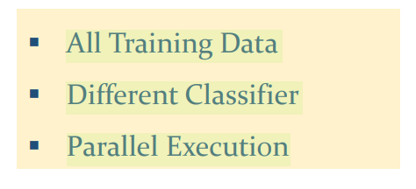
Example:
Notes:
One example of a real-world problem that can be solved by the voting ensemble method is predicting the outcome of an election. By combining the predictions of multiple models, you can produce a more accurate prediction of who will win the election. This can be helpful for political campaigns, news outlets, and voters themselves.

Slide 22
02
Boosting (reduce the Bias)
Boosting is an Ensemble Learning technique that makes use of a set of base learners to improve the stability and effectiveness of a ML model. Boosting architecture is the generation of sequential hypotheses.
The central idea of boosting is the implementation of homogeneous (same classifier) ML algorithms in a sequential way, where each of these ML algorithms tries to improve the stability of the model by focusing on the errors made by the previous one. The way in which the errors of each base learner are considered to be improved with the next base learner in the sequence.
Notes:
involves adding ensemble members sequentially that correct the predictions made by prior models and outputs a weighted average of the predictions.

Slide 23
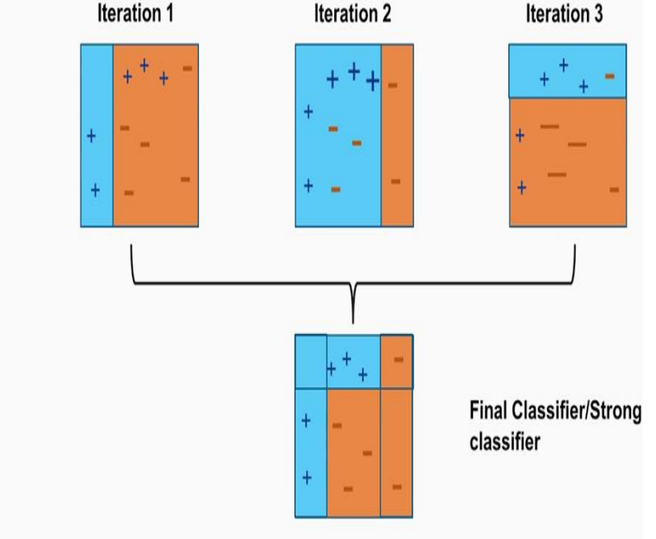
Example:
Notes:
How it’s work
The first step is to select a number of weak learners or models. These can be any type of model, but typically simple models are used.
Each of the weak learners is then trained on a separate subset of the data.
The final step is to combine the results of the individual learners into a single, stronger model. This is typically done by taking a weighted average of the results, with the weights being based on the accuracy of each individual learner.
Sequential

Slide 24
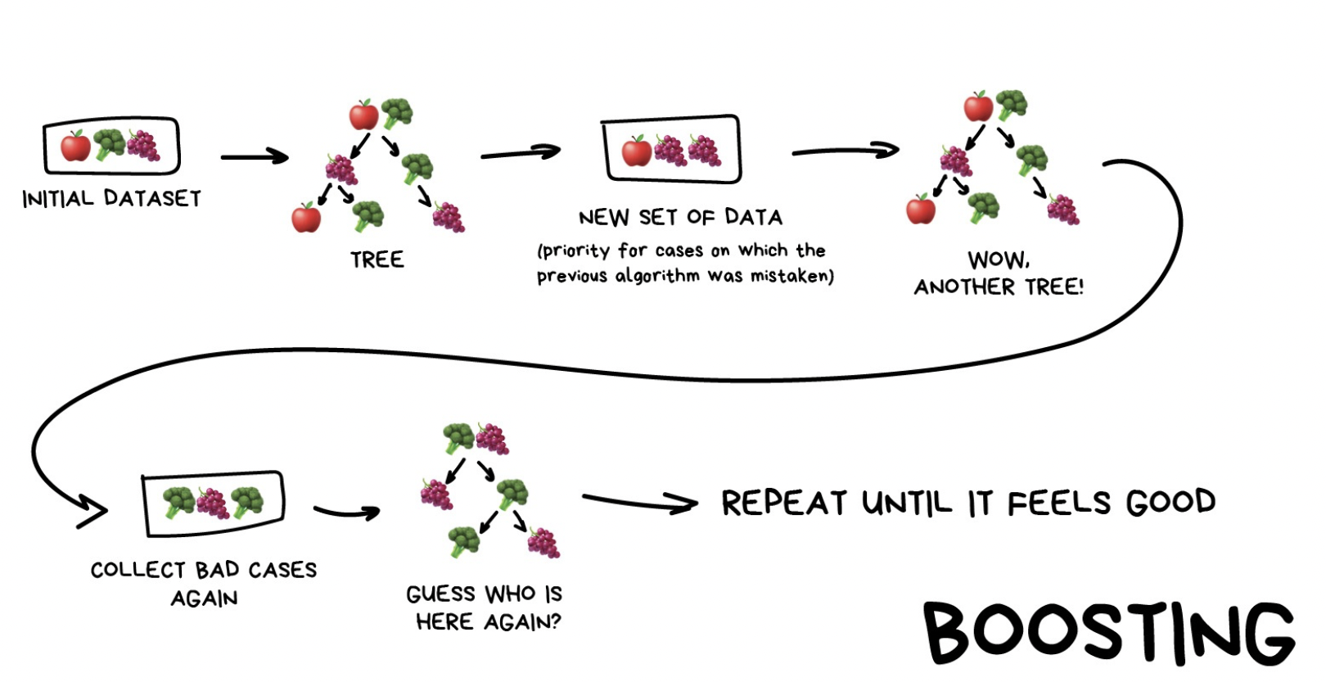
Example:
Notes:
How it’s work
The first step is to select a number of weak learners or models. These can be any type of model, but typically simple models are used.
Each of the weak learners is then trained on a separate subset of the data.
The final step is to combine the results of the individual learners into a single, stronger model. This is typically done by taking a weighted average of the results, with the weights being based on the accuracy of each individual learner.
Sequential

Slide 25
03
Bagging (Bootstrap Aggregating)
Bagging or Bootstrap Aggregation is an Ensemble Learning technique that aims to reduce the learning error through the implementation of a set of homogeneous machine learning algorithms.
The key idea of bagging is the use of multiple base learners who are trained separately with a random sample from the training set, the final prediction is made through a voting or averaging approach. This method produces a more stable and accurate model.
The main two components of the bagging technique are:
1- the random sampling with replacement (bootstrapping)
2- the set of homogeneous machine learning algorithms (ensemble learning).
Notes:
involves fitting many decision trees on different samples of the same dataset and averaging the predictions.

Slide 26
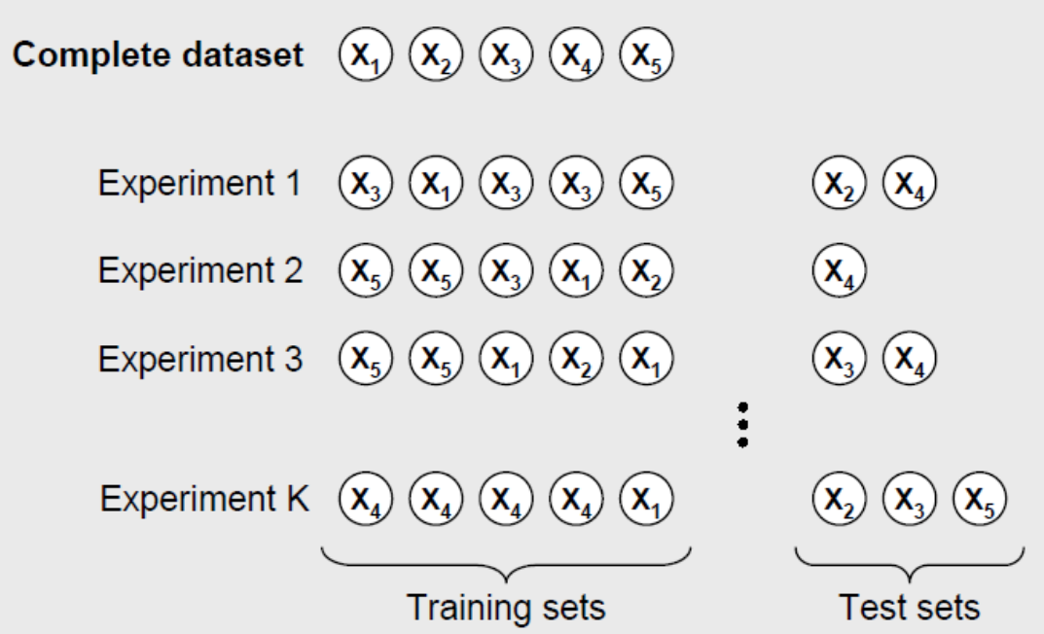
Bootstrapping:
Notes:
how it’s work:
first it is extracted “n” subsets from the training set, then these subsets are used to train “n” base learners of the same type. For making a prediction, each one of the “n” learners are feed with the test sample, the output of each learner is averaged (in case of regression) or voted (in case of classification). Figure 1 shows an overview of the bagging architecture.
Parallel

Slide 27
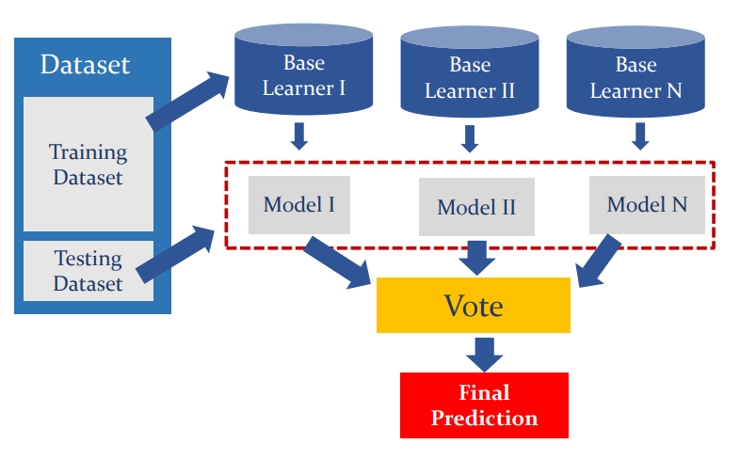
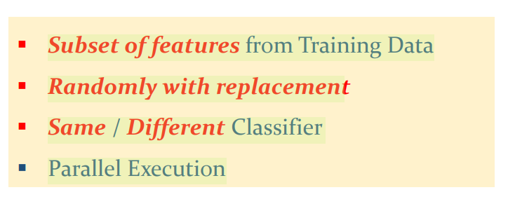
Example:
Notes:
how it’s work:
first it is extracted “n” subsets from the training set, then these subsets are used to train “n” base learners of the same type. For making a prediction, each one of the “n” learners are feed with the test sample, the output of each learner is averaged (in case of regression) or voted (in case of classification). Figure 1 shows an overview of the bagging architecture.
Parallel

Slide 28
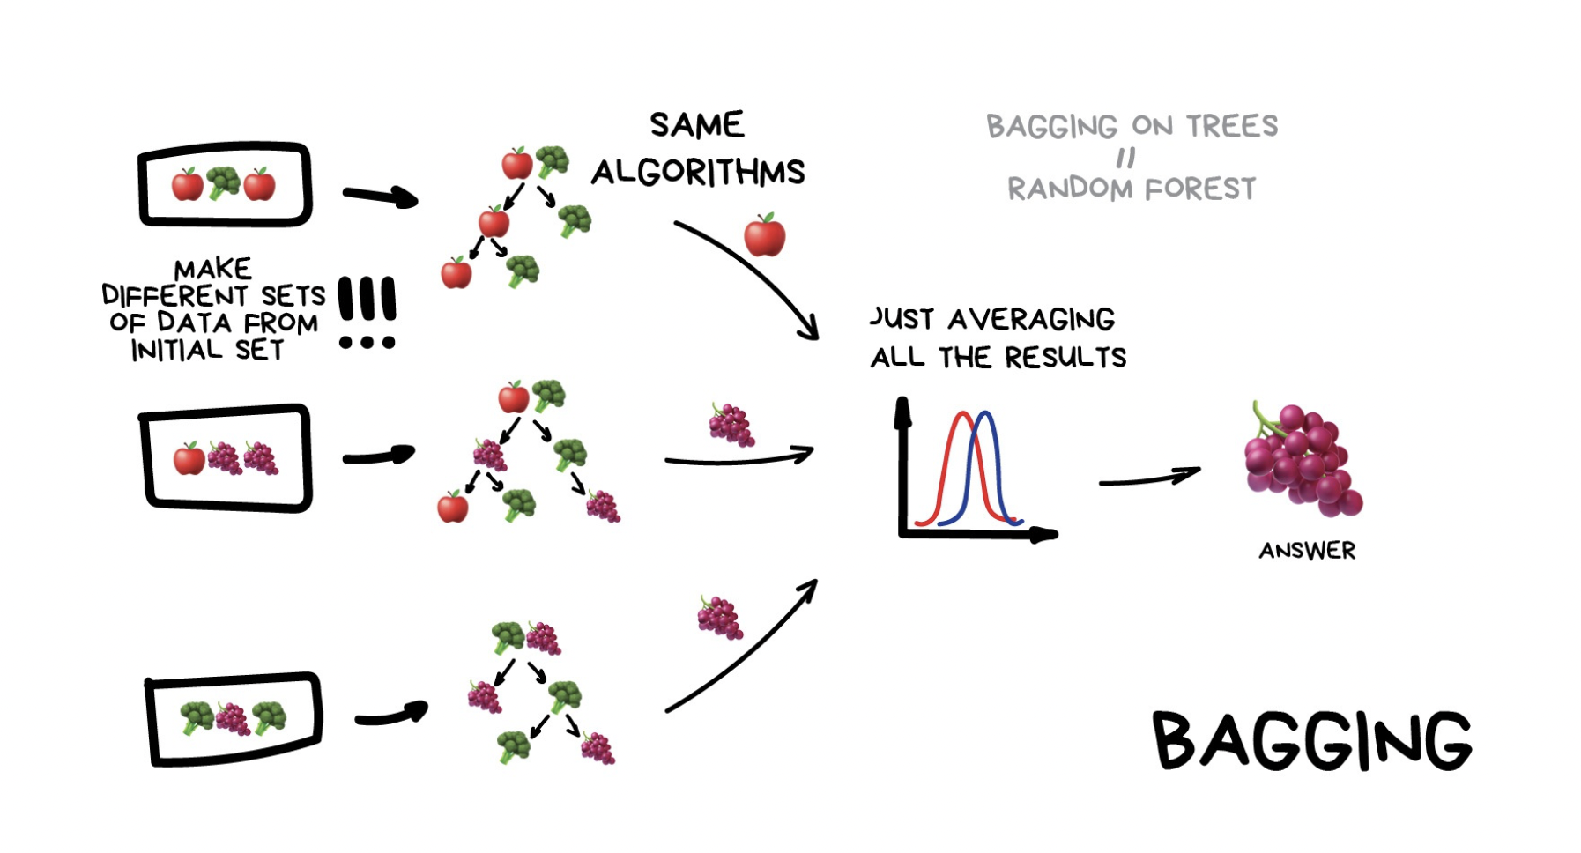
Example:
Notes:
how it’s work:
first it is extracted “n” subsets from the training set, then these subsets are used to train “n” base learners of the same type. For making a prediction, each one of the “n” learners are feed with the test sample, the output of each learner is averaged (in case of regression) or voted (in case of classification). Figure 1 shows an overview of the bagging architecture.
Parallel

Slide 29
04
Stacking
bagging and boosting use homogenous weak learners, while Stacking uses heterogeneous (different classifiers) weak learners, learns them in parallel, and combines them by training a meta-learner to output a prediction based on the different weak learner’s predictions.
A meta learner inputs the predictions as the features and the target being the ground truth values in data it attempts to learn how to best combine the input predictions to make a better output prediction.
Notes:
involves fitting many different models types on the same data and using another model to learn how to best combine the predictions.

Slide 30
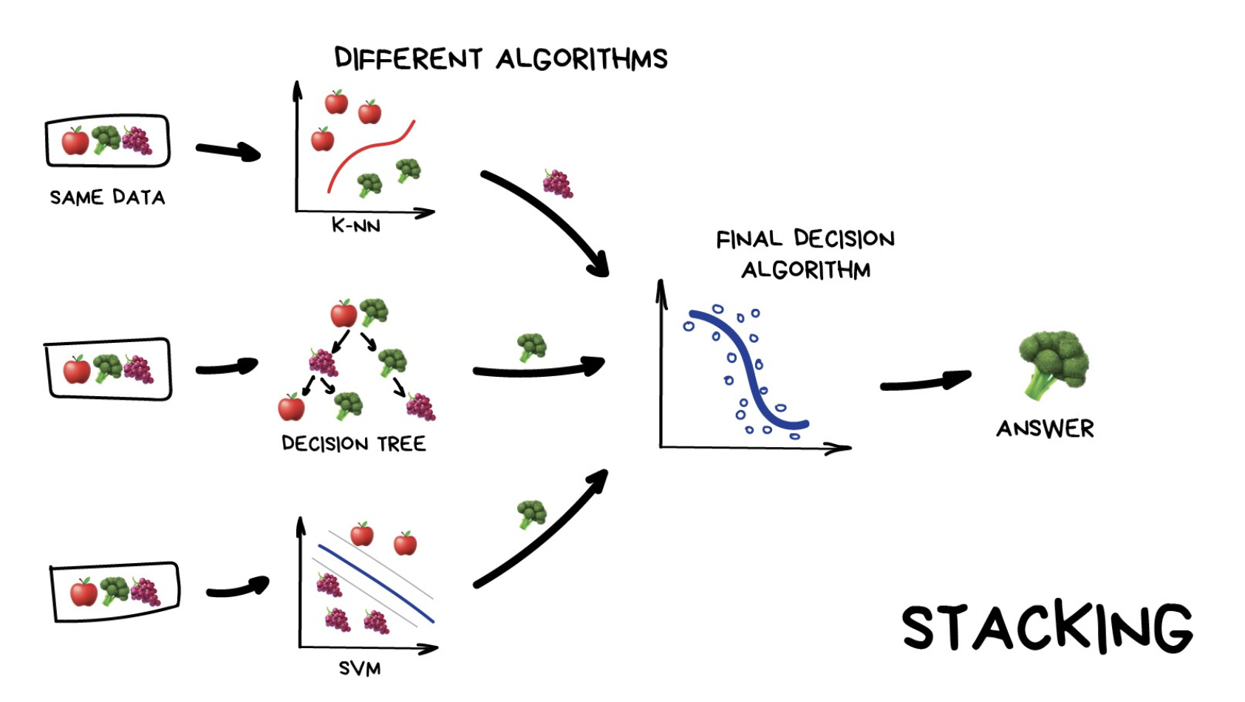
Example:

Slide 31
THANK YOU!!
Any questions
?
?
?
Notes:
Thank you! Informed and great presentation

